Slide 1



Understanding LightGBM
LightGBM is a powerful and efficient gradient boosting framework that has gained significant popularity in the machine learning community. It is known for its speed, memory efficiency, and ability to handle large-scale data.
by Praveen kumar T G

Slide 2
How LightGBM Works
Gradient Boosting
Optimization Techniques
LightGBM uses gradient boosting, a technique that iteratively builds weak models and combines them to create a strong, accurate model.
LightGBM employs various optimization techniques, such as histogram-based algorithm and gradient-based one-side sampling, to improve efficiency and speed.
1
2
3
Tree-Based Learning
LightGBM constructs decision trees to capture complex relationships in the data, allowing for accurate predictions.

Slide 3
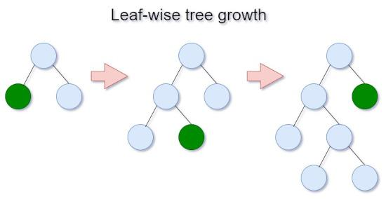

Slide 4
Advantages of LightGBM
High Performance
Memory Efficient
Scalability
LightGBM is known for its exceptional speed and accuracy, making it a top choice for large-scale machine learning problems.
LightGBM requires less memory compared to other tree-based algorithms, allowing it to handle datasets that may be too large for other methods.
LightGBM can handle large-scale data and can be easily distributed across multiple machines, making it suitable for big data applications.

Slide 5
Applications of LightGBM
Classification
Regression
LightGBM is highly effective in tackling classification problems, such as credit card fraud detection, spam filtering, and image classification.
LightGBM excels in regression tasks, including stock price prediction, demand forecasting, and real estate price estimation.
Ranking
Multiclass Classification
LightGBM's powerful ranking capabilities make it a top choice for search engine optimization, recommendation systems, and online advertising.
LightGBM can handle multiclass classification problems, such as text categorization, document clustering, and multi-label classification.

Slide 6
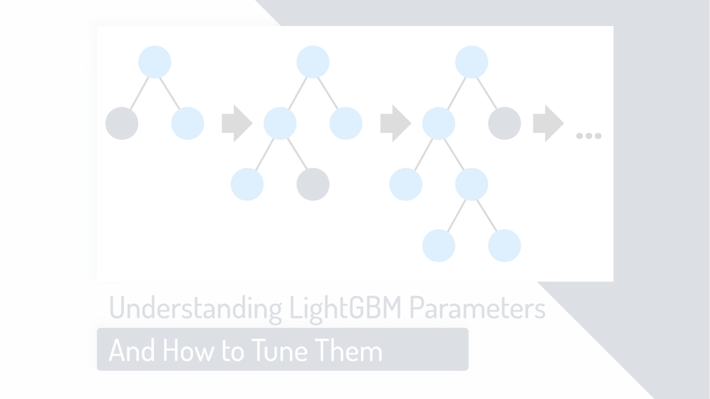
Key Features of LightGBM
1
Gradient Boosting
2
Tree-based Algorithm
3
Optimization Techniques
LightGBM uses gradient boosting, a powerful ensemble learning technique, to build a strong predictive model from a collection of weak learners.
LightGBM employs a tree-based algorithm, which is highly effective in capturing complex relationships in the data.
LightGBM incorporates several optimization techniques, such as histogram-based algorithm and gradient-based one-side sampling, to improve efficiency and performance.

Slide 7
Hyperparameter Tuning in LightGBM
Num Leaves
Controls the complexity of the model, balancing overfitting and underfitting.
Learning Rate
Determines the step size at each iteration, affecting the overall convergence speed.
Max Depth
Limits the depth of each tree, preventing overfitting and improving generalization.
Reg Alpha/Lambda
Regularization parameters that control the complexity and prevent overfitting.

Slide 8
LightGBM Use Cases
E-commerce
Product recommendation, customer churn prediction, and fraud detection.
Finance
Credit risk modeling, stock price prediction, and portfolio optimization.
Healthcare
Disease diagnosis, patient risk prediction, and drug discovery.
Marketing
Customer segmentation, campaign optimization, and lead generation.

Slide 9
Conclusion and Key Takeaways
Powerful Performance
LightGBM is a highly efficient and accurate machine learning algorithm that can handle a wide range of tasks.
Versatile Applications
LightGBM has been successfully applied across various industries, including e-commerce, finance, healthcare, and marketing.
Optimization Capabilities
LightGBM's optimization techniques, such as histogram-based algorithm and gradient-based one-side sampling, contribute to its speed and efficiency.
Hyperparameter Tuning
Carefully adjusting hyperparameters, such as num leaves, learning rate, and regularization, can further improve LightGBM's performance.

Slide 10
Thank You

